Slide 1
Meeting a Mate in Four Minutes
Exploring Speed dating at Columbia university

Slide 2
Database Breakdown of Kaggle Dataset
Participants
Kaggle Dataset
Dates
Self Rated Attributes
Average Rating of Attributes

Slide 3
Speed Date Event Format
6-22 dates
Break halfway through the event
Rate each partner on 6 attributes
Give a ‘yes’ or ‘no’ decision for each partner
Two scenarios:
1) Give a ‘yes’ decision to as many partners as you wish
2) Limited to ‘yes’ decision for half of the partners you meet
Attributes
Attractiveness
Intelligence
Sincerity
Ambition
Shared Interests
Fun

Slide 4
How does the order of a speed date affect your decision?

Slide 5
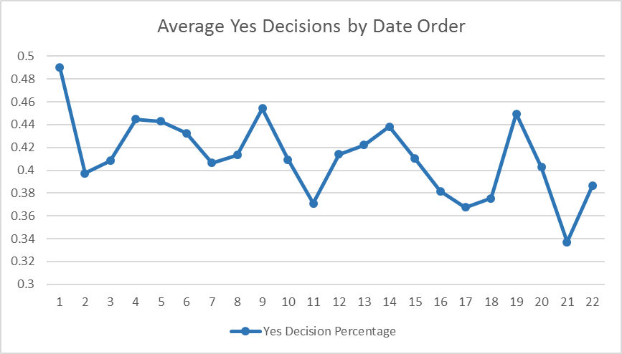
Average Yes Decisions by Date Order
Key Take Aways:
First dates are by far the most likely to match
Peaks in ‘yes’ decisions align with post-break dates
Downward trend as event progresses

Slide 6
Building and Baselining a Logistic Regression
Random guessing provides a 50% accuracy score
A basic logistic regression using just one feature predicted both matches and decisions with over 70% accuracy
How attractive a participant was rated by their parnter

Slide 7
Using K-Means to Classify by Self Rating of Attractiveness

Slide 8
K-Means Classification by Self Rated Attractiveness
 | Females |  |  |  |  | Males
Number of Matches | 2.4 | 2.9 | 2.5 | 3.0 | 2.2 | 3.8 | 2.0 | 2.8 | 3.0 | 2.0
Self Rated Attractiveness | 9.2 | 8.0 | 7.0 | 5.7 | 3.4 | 9.4 | 8.0 | 7.0 | 5.6 | 3.6
Avg Attractiveness Rating | 6.8 | 6.5 | 6.5 | 6.2 | 5.7 | 6.8 | 6.0 | 5.8 | 5.7 | 5.0

Slide 9
K-Means Classification by Self Rated Attractiveness
 | Females |  |  |  |  | Males
Number of Matches | 2.4 | 2.9 | 2.5 | 3.0 | 2.2 | 3.8 | 2.0 | 2.8 | 3.0 | 2.0
Self Rated Attractiveness | 9.2 | 8.0 | 7.0 | 5.7 | 3.4 | 9.4 | 8.0 | 7.0 | 5.6 | 3.6
Avg Attractiveness Rating | 6.8 | 6.5 | 6.5 | 6.2 | 5.7 | 6.8 | 6.0 | 5.8 | 5.7 | 5.0

Slide 10
K-Means Classification by Self Rated Attractiveness
 | Females |  |  |  |  | Males
Number of Matches | 3.0 | 2.9 | 2.5 | 2.2 | 2.4 | 3.0 | 2.0 | 2.8 | 2.0 | 3.8
Self Rated Attractiveness | 5.7 | 8.0 | 7.0 | 3.4 | 9.2 | 5.6 | 8.0 | 7.0 | 3.6 | 9.4
Avg Attractiveness Rating | 6.2 | 6.5 | 6.5 | 5.7 | 6.8 | 5.7 | 6.0 | 5.8 | 5.0 | 6.8

Slide 11
Using K-Means to Classify by Average Partner Rating of Attractiveness

Slide 12
K-Means Classification by Partner Rated Attractiveness
 | Females |  |  |  |  | Males
Number of Matches | 3.8 | 3.5 | 2.2 | 1.7 | 1.4 | 4.9 | 3.4 | 3.1 | 2.2 | 0.9
Self Rated Attractiveness | 7.5 | 7.2 | 7.0 | 7.0 | 6.2 | 7.6 | 7.7 | 6.9 | 6.6 | 6.4
Avg Attractiveness Rating | 7.9 | 7.0 | 6.2 | 5.2 | 4.1 | 7.9 | 7.0 | 6.2 | 5.2 | 4.1

Slide 13
Building a better model using Random Forest

Slide 14
Random Forest Feature Importance
Predicting Matches
F rating of Partner Shared Interests
M rating of partner Attractiveness
Female Age
F rating of Partner Fun
Predicting Female Decisions
Shared Interests
Fun
Attractiveness
Predicting Male Decisions
Attractiveness
Shared Interests
Fun

Slide 15
Optimizing the Random Forest
Accuracy Score: Over 80%
Features used:
Female Age
F rating of partner attractiveness
M rating of partner attractiveness
F rating of partner fun
M rating of partner fun
F rating of partner shared interests
M rating of partner shared interests
Order
Age Difference

Slide 16
How does attribute correlation with decision vary as choices become limited?

